Slide 1

Financial Literacy Workshop

Slide 2
Rich vs Wealthy
Question: What is the difference between being rich and being wealthy?
Notes:
Being rich is simply having a lot of money or income. It comes down to how much cash you have in your bank account. But just because you’re rich, doesn’t mean you are wealthy.
In fact, being rich can often mean that you are spending a lot of money. It can also mean that you have a lot of debt. It doesn’t matter how much money you have if your expenses are higher than your income. Being in debt is definitely not something to aspire to!
If you make $200,000 a year, but spend $225,000 a year in expenses, you might seem rich, but you’re on your way to going broke.
Being wealthy is not only having enough money to meet your needs but being able to afford not to work if you don’t have to. It’s about amassing assets and making your money work for you. In other words, it’s having a significant net worth.
Wealthy people don’t necessarily own the latest gadgets or cars or throw lavish parties. What they do have, is a lot of assets, such as real estate, investments, and cash.
Wealthy people don’t have to work.. They have their money working for them
Becoming wealthy means you have:
Time to do the things you want to do
Time to spend with the people you love
Time to learn about the things you want to learn abou

Slide 3
Debt
Debt is anything owed by one person to another
Types of Debt
Credit Cards
School Loans
Mortgage
Net Worth = Assets – Liabilities
Debt

Slide 4

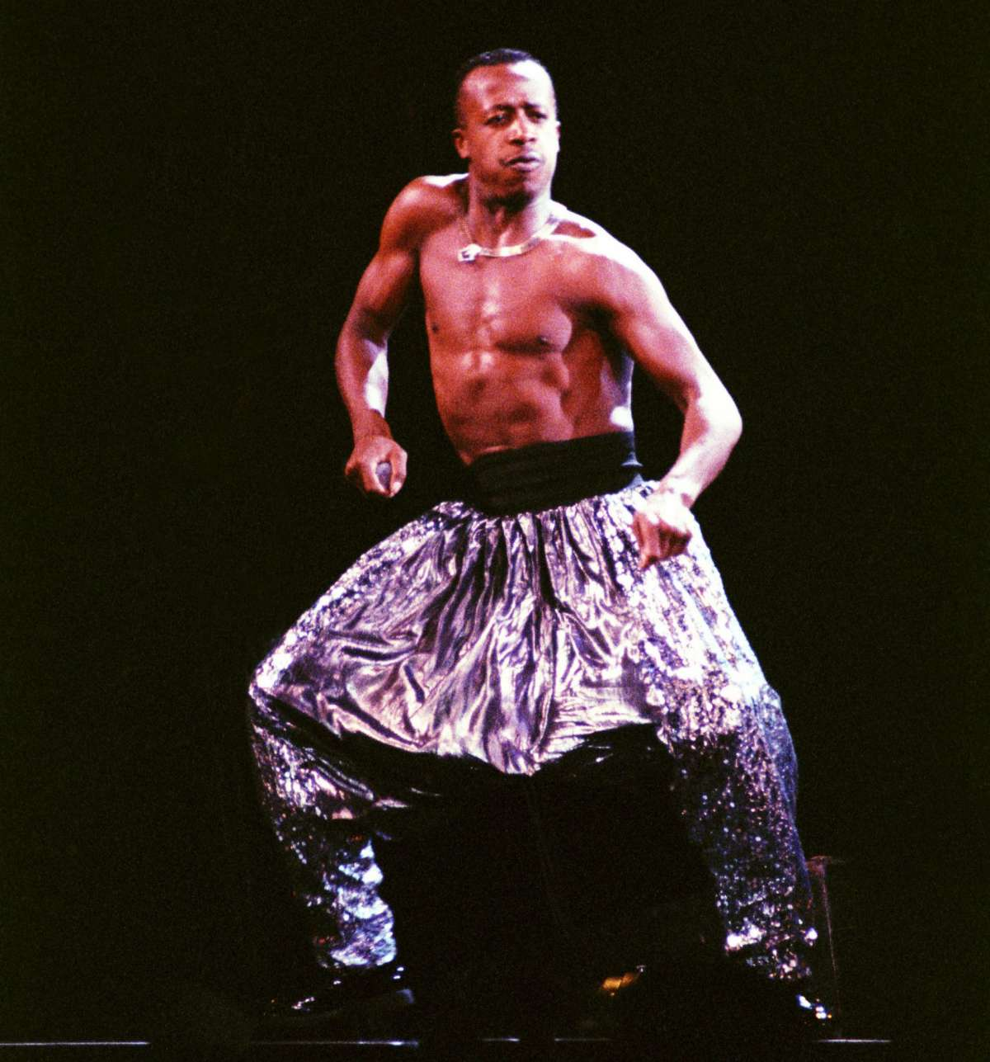
Notes:
MC Hammer had a legitimate hit with "U Can't Touch This" and the rapper soon had $30 million in the bank. Thanks to his success, Hammer bought a $1 million mansion that he made $30 million worth of adjustments to and staffed 200 people in his home. He also bought a horse stable where he kept 19 racehorses.
Combined with his unrestrained spending and numerous lawsuits, Hammer declared bankruptcy in 1996 while he was reportedly $13 million in debt.

Slide 5
Why Start Early?

Slide 6
Budgeting Exercise

Slide 7
Saving & Investing
What is a bank doing with my money?
Interest Rates
Inflation
$1 today is not worth $1 tomorrow!
Investments
Stocks
Bonds
Real Estate

